Slide 1


ASTOS Results Analysis
and Post-Processing
Jason Ong

Slide 2

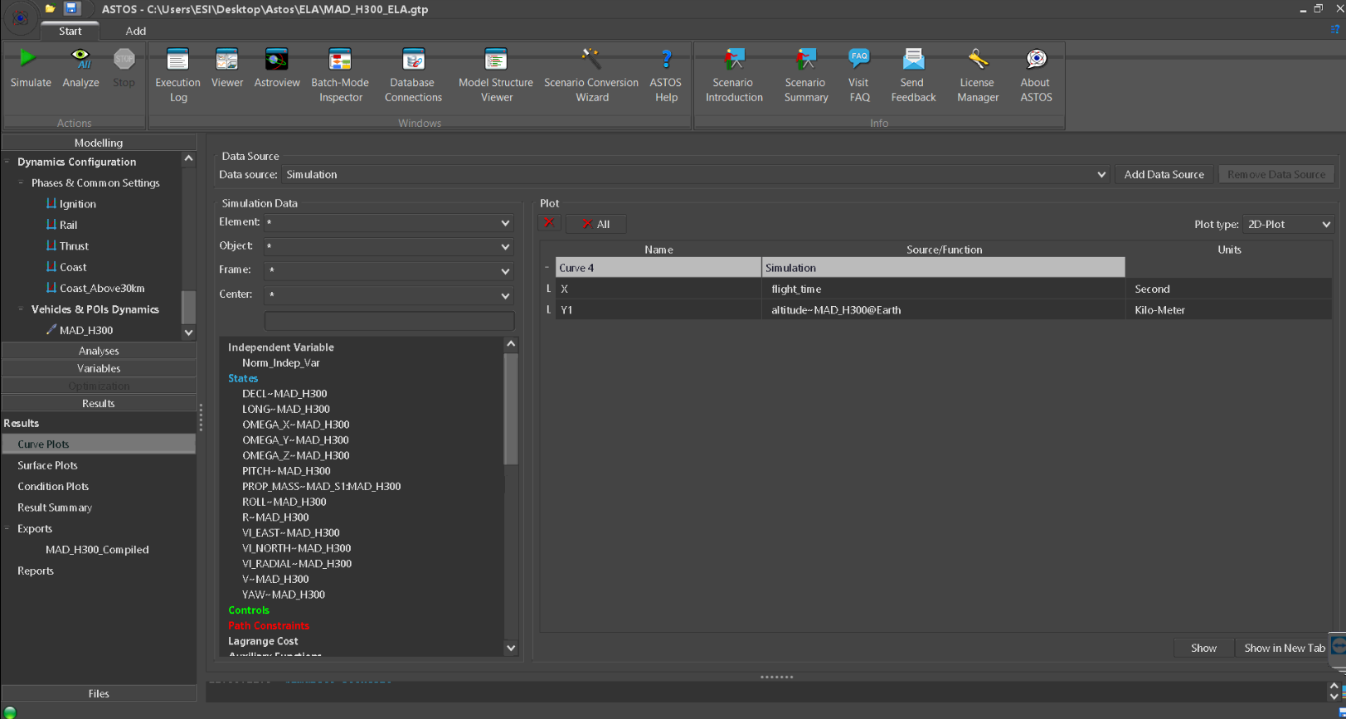
Variable selection
Plot button
Results panel

Slide 3
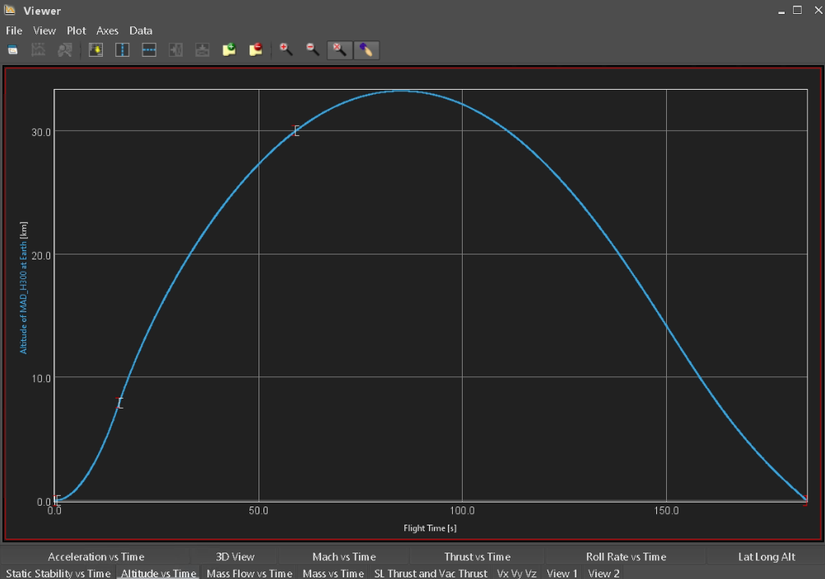
Results Viewer
I symbol – end of each phase

Slide 4
Remove tab
Zoom in/out/fit window
New tab
Select data point on curve
Results Viewer

Slide 5
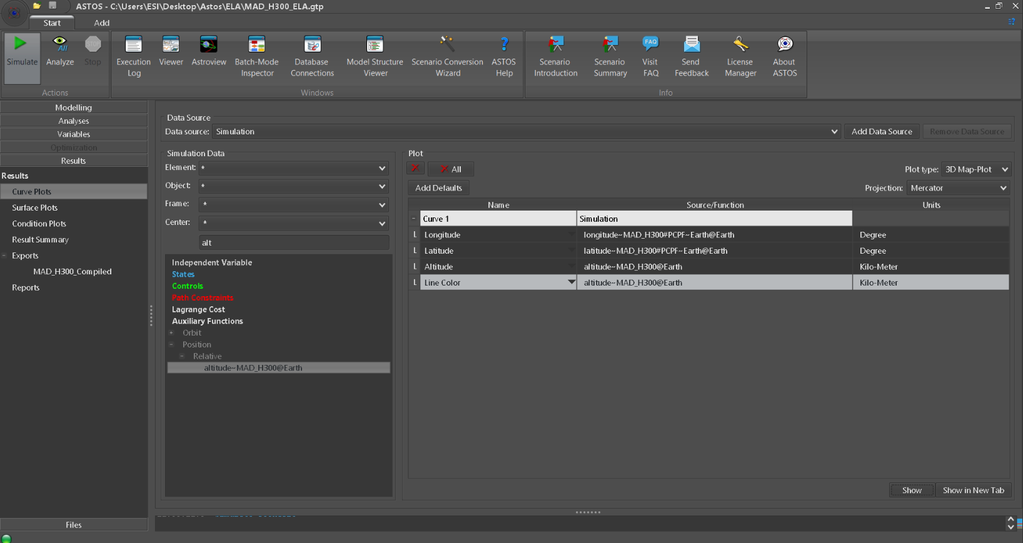
3D Map Plot

Slide 6
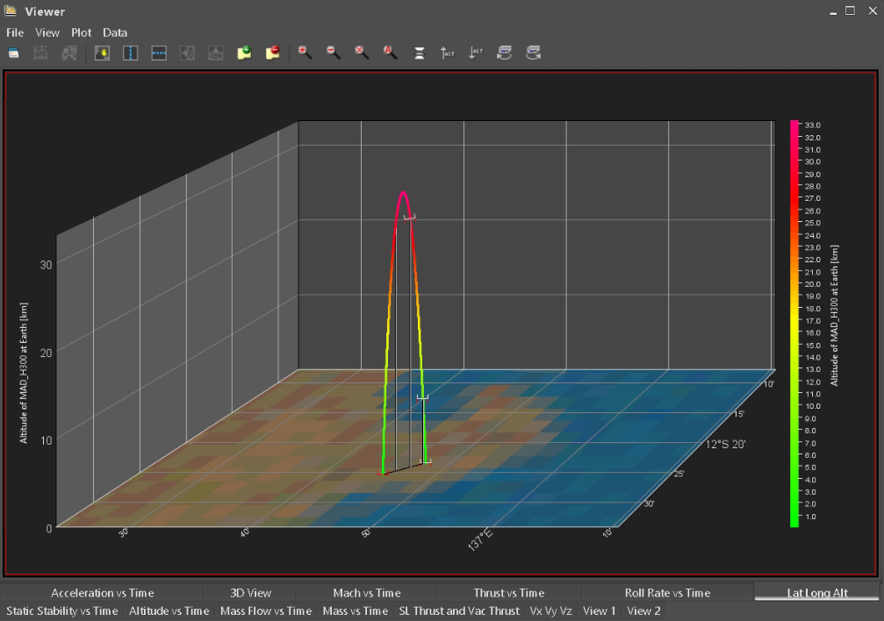
3D Map Plot

Slide 7
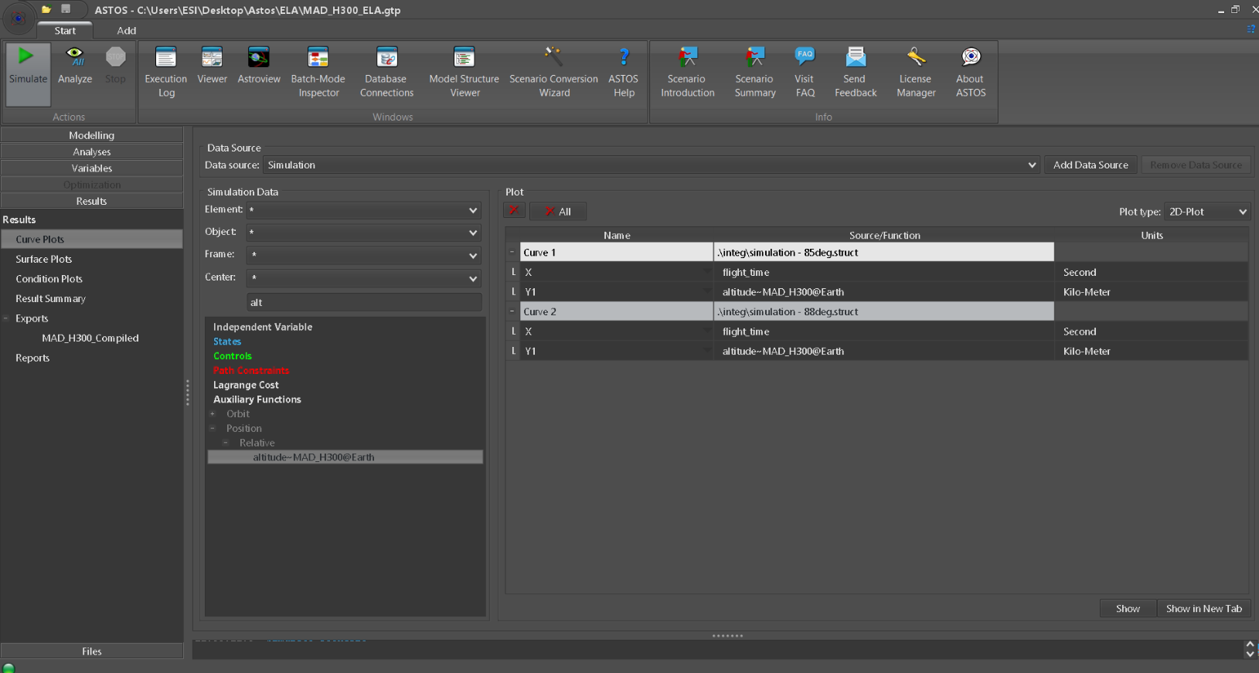
Add different .struct files for plotting
Multi-plot comparison
Note: Simulation.struct is always overwritten for every simulation run. Copy and rename to load it for plot comparisons/post-processing later on.

Slide 8
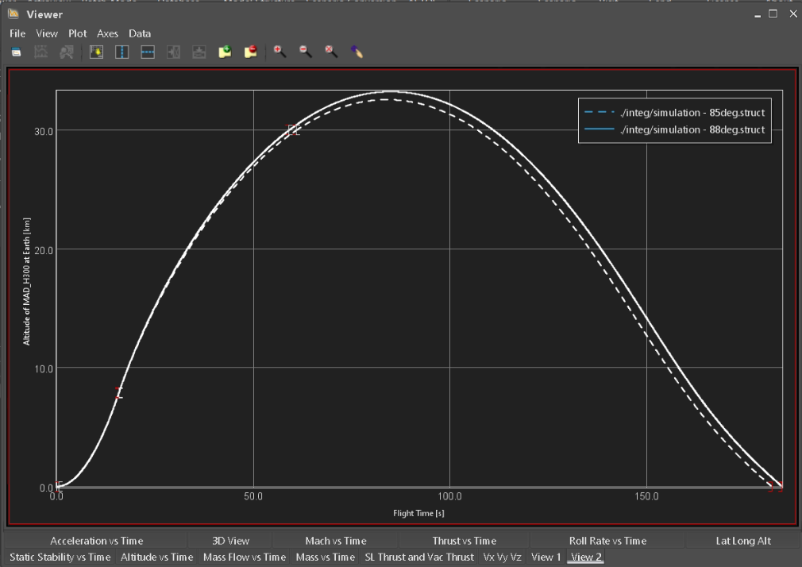
Multi-plot comparison

Slide 9
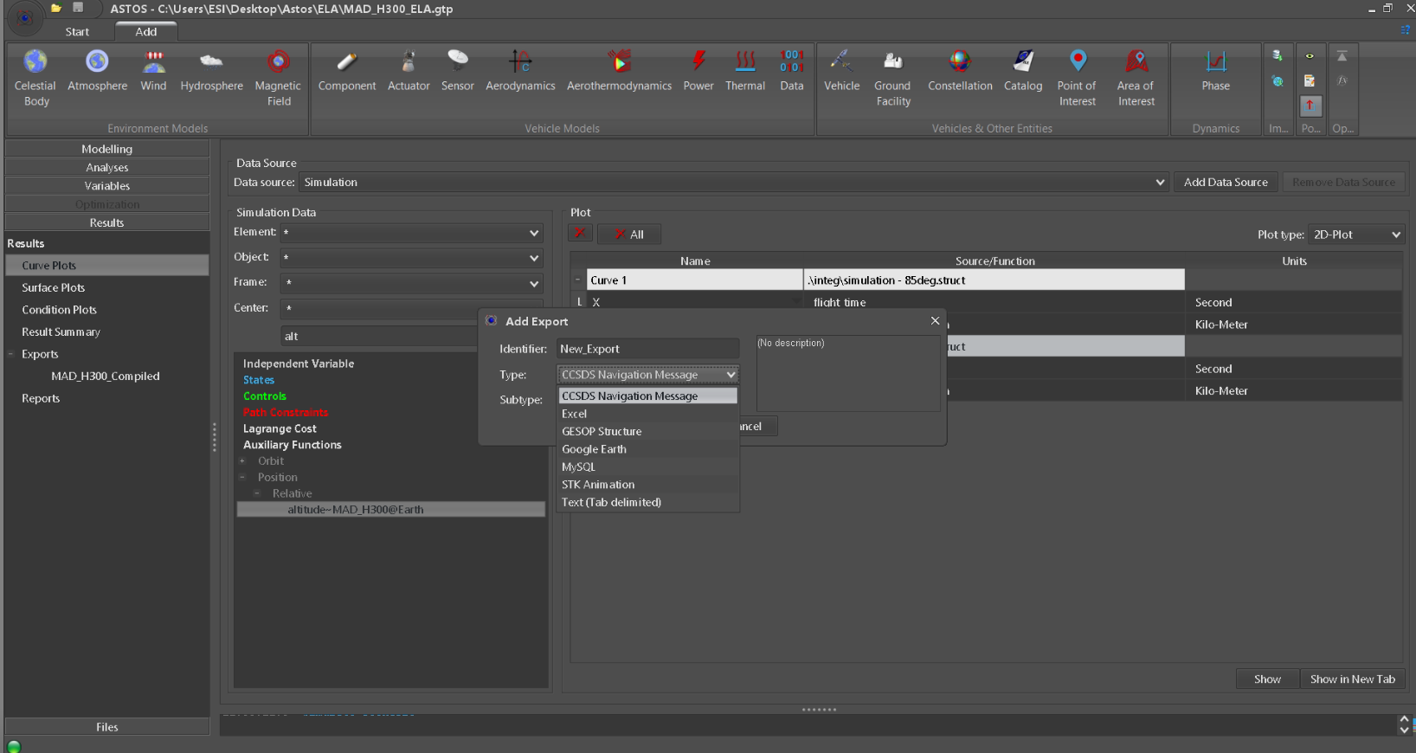
Export icon
Export file types (Excel is typically used)

Slide 10
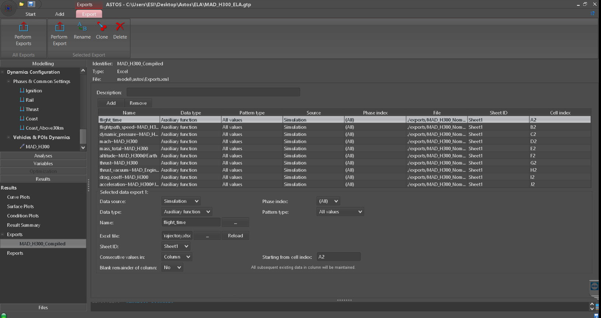
Data selection for export
Variable selection
Excel file
Sheet ID
Cell start

